Slide 1
Shipment Cost Prediction for a Logistics Company
Addiwar Lucky Reddy

Slide 2
Table of Contents
1.Problem Statement
2.Purpose
3.Data
4.Feature Engineering
5.Visualisations
6.Model / Analysis
7.Results
8.Conclusion

Slide 3

Problem Statement:
SwiftFreight is the delhivery partner between the customer and freight services. This partner charge from the customer and pay to the freight services and during the transaction they will make their profit/revenue. The problem is arriving that how much amount they should charge from customer for shipment . So they would like to decide the estimated cost for the carriers.

Slide 4
PURPOSE
To decide the estimated cost for the carriers.
This information will enable them to quote the best price for the customer.
Reduce revenue leakages .
Increase their bottom line.

Slide 5

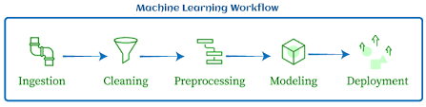
Machine Learning

Slide 6
Information about variables
Variable
1 ORDER_NBR
2 EQUIPMENT_TYPE
3 CUSTOMER_MILES
4 WEIGHT
5 ORDER_COST
6 FIRST_PICK_ZIP
7 FIRST_PICK_EARLY_APPT
8 FIRST_PICK_LATE_APPT
9 LAST_DELIVERY_ZIP
10 LAST_DELIVERY_EARLY_APPT
11 LAST_DELIVERY_LATE_APPT
12 IS_HAZARDOUS
Notes:
We have total 12 variables in that our target variable is ORDER_COST which is continuous so our problem is regression.And other columns will considered as predictors.We have two Zipcodes variables and 5 Date related variables.

Slide 7
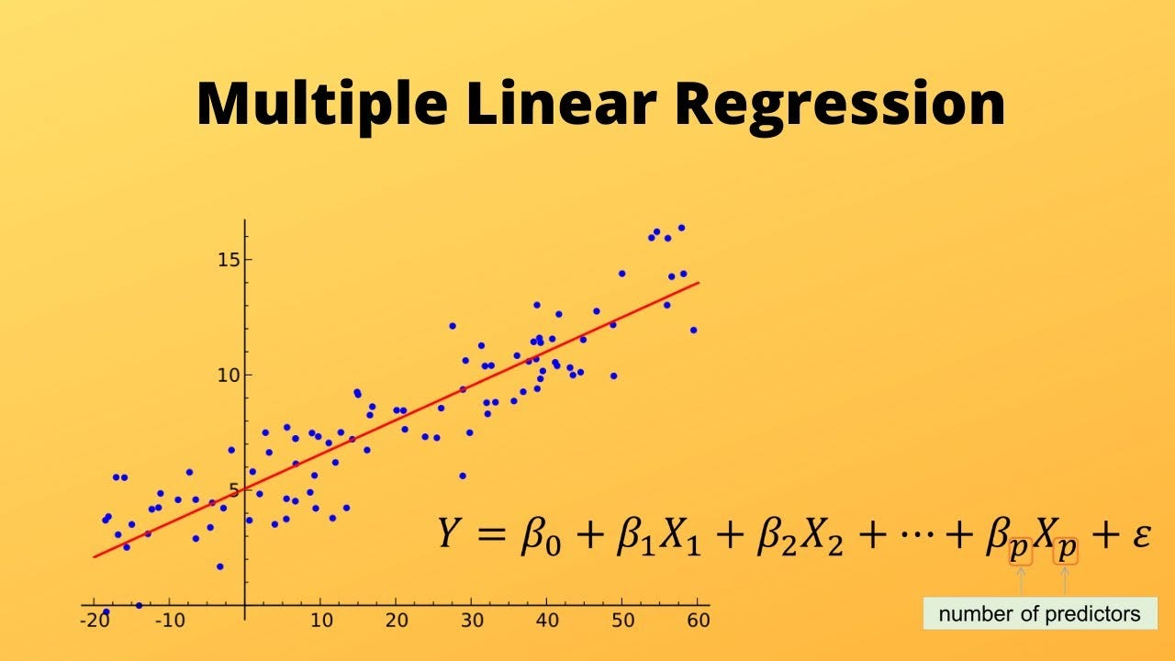

Slide 8
About Data
Rows:18739
Duplicated values:0
Null values : Yes in 6 COLUMNS

Slide 9
Feature Engineering
Time_BETWEEN_EARLY
Time_BETWEEN_LATE
FIRST_PICK_DURATION
LAST_DELIVERY_DURATION
ORDER_PROCESSING_TIME
ORDER_DURATION

Slide 10
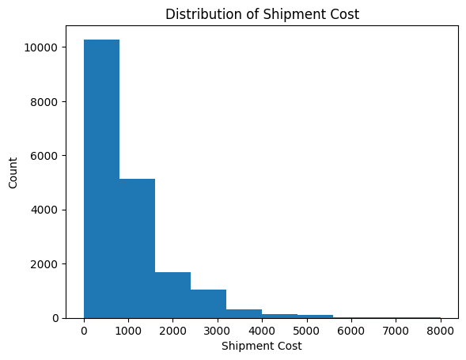
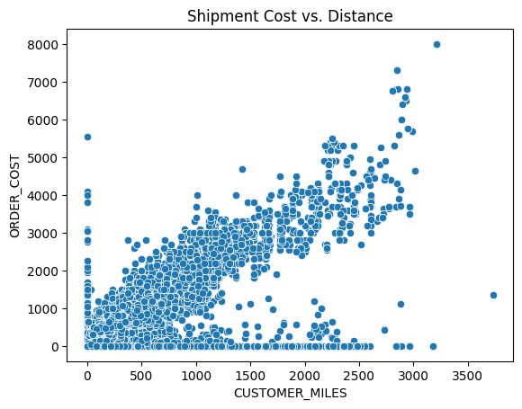
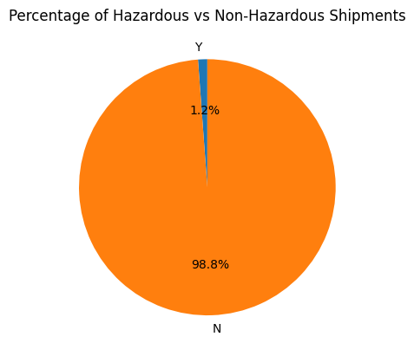
Exploratory Data Analysis

Slide 11
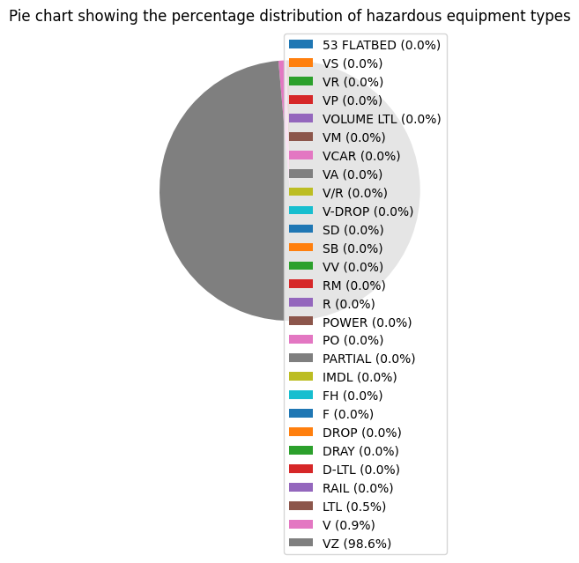
VZ type shipment is used for hazardious type .

Slide 12
Data Cleaning/preprocessing
Null values Imputation
Encoding for categorical columns
Standardization for Numerical columns

Slide 13
Models
Lasso
Decision Tree Algorithms
RandomForestRegressor
BaggingRegressor
GradientBoostingRegressor

Slide 14
ERROR MATRICS USED
Mean Squared Error (MSE).
Root Mean Squared Error (RMSE).
Mean Absolute Error (MAE)

Slide 15
Results
Among all the models GradientBoostingRegressor with transformed dependent variable given better performance if measures the average magnitude of the residuals (i.e., the differences between predicted and actual values) and provides an estimate of the model's prediction error.
But if we see better fit that is R^2 BaggingRegressor with hyper parameter tuning given better results.

Slide 16
Conclusion
I thought among all the models BaggingRegressor with hyper parameter tuning is better and decided to predict for test data using same algorithm.
So now logistic company can estimate the price and they can charge from customers to get profits and also not charge more from customers.

Slide 17
Thank You

